Slide 1





IMPACT OF NEWLY INSTALLED CITY BUSES ON TAXI DRIVERS AND PASSENGERS.
Team Mavericks - AI “A” Group 3

Slide 2

Outline
Abstrat | 3
Keywords | 4
Introduction | 5
Literature Review | 6
Methods | 7
Results and Discussion | 8
Conclusion | 9
Acknowledgement | 10
References | 11
Supporting Materials | 13

Slide 3

Abstract
The study examines the impact of newly installed city buses on taxi drivers and passengers in Thimphu, Bhutan.
Taxi drivers are concerned about declining customer volume and earnings, but do not see the need to make significant adjustments to their offerings.
Passenger perceptions of the city bus service in Thimphu are generally positive, with statistical metrics demonstrating consensus on factors like affordability, environmental effect, and decreased dependency on taxis.
The research methodology involves a quantitative approach, utilizing surveys and questionnaires to gather insights from both passengers and taxi drivers in Thimphu Thromde

Slide 4


City buses
Taxi Drivers
Passenger perceptions
Transportation impact
Public Transportation
Keywords

Slide 5


Introduction
Research focus : Impact of the new municipal bus system in Thimphu Thromde.
Objective : Understand how the system affects passengers and taxi drivers
Significance: Contribute insights for policymakers and urban planners.
Novelity : Unique focus on specific impacts, addressing a knowledge gap.
Goals : Enhance passenger experience, improve bus services, support taxi drivers, and indirectly promote environmental sustainability.

Slide 6
Research Approach Quantitative research methodology.
Data Collection Method Utilization of surveys and questionnaires.
Participants Passenger and taxi drivers in Thimphu
Analysis Measurement and statistical analysis.
Methodology

Slide 7

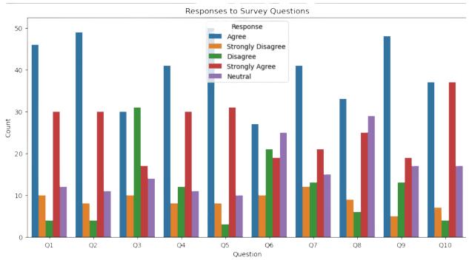
Results
Taxi Driver Survey
100 DRIVERS
Total Participants
THIMPHU
Location

Slide 8

Taxi Driver Survey
Discussion
City buses viewed negatively by taxi drivers.
Major impact on earnings, decreased passenger volume, and reduced flexibility in work schedules.
Perception of a detrimental effect on the taxi business as a whole.
Increased difficulty in finding passengers.

Slide 9
Taxi Driver Survey
Discussion
No inclination to improve taxi quality or reduce fares.
No consideration of a career change.
Absence of noticeable rise in traffic congestion.
Drivers not actively demanding government assistance.
Findings highlight specific concerns among taxi drivers.
Offers valuable information for potential changes to legislation and prompts further research.

Slide 10
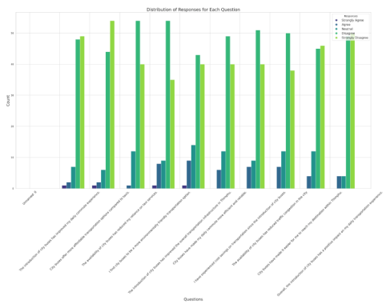
Results
Passenger Survey
106 PASSENGER
Total Participants
THIMPHU
Location

Slide 11
Passenger Survey
Discussion
People generally have a positive perception of the city bus service.
They agree that it has improved their daily commute, is affordable, and contributes positively to the environment and overall transportation.
Across different survey questions, most people strongly agree or agree with the positive impact of city buses.
There's a noticeable increase in positive sentiments.

Slide 12
Passenger Survey
Discussion
The survey indicates a clear and meaningful shift in how people view transportation since the introduction of city buses.
While there is a strong consensus in favor of city buses, there are some differing opinions, showing a range of views among respondents.
The visual representation of survey responses reinforces that the city bus service is seen as successful and well-received in Thimphu.

Slide 13
CONCLUSION
This study on Thimphu Thromde's new city bus system, led by Ms. Chimi Dema, used a robust mixed-methods approach, addressing a literature gap. It provides valuable insights for urban planning and sustainable development. Future researchers could explore long-term effects, community engagement, and innovative solutions to enhance public transportation and taxi services.

Slide 14
Acknowledgement
The study's completion is attributed to the vital support and guidance of key individuals. Gratitude is extended to Ms. Chimi Dema, Research Lecturer, for her valuable expertise. Sincere thanks to participants, especially taxi drivers and passengers, whose input significantly enriched and ensured the success of the study.

Slide 15
References
Abekah-Nkrumah, G., Asuming, P. O., & Telli, H. (n.d.). The effects of the introduction of a bus rapid transit system on commuter choices in Ghana
Ahmed, S. (n.d.). The Impact of Select Buses on Taxi Ridership in NYC. Hill, S. (2018, March 27). Ridesharing Versus Public Transit. The American Prospect. https://prospect.org/infrastructure/ridesharing-versus-public-transit/
Kugii, L., Fukuda, A., Tsumita, N., & Kikuchi, H. (n.d.). Analysis of Impact of Introduction of Bus Rapid Transit on Land Price in Developing City—Case Study of Managua city, Republic of Nicaragua -.
Zhong, J., Zhou, H., Lin, Y., & Ren, F. (2022). The impact of ride-hailing services on the use of traditional taxis: Evidence from Chinese urban panel data. IET Intelligent Transport Systems, 16(11), 1611–1622. https://doi.org/10.1049/itr2.1223

Slide 16
Thank You

